Slide 1

Text to SQL using LLM
Suresh Kumar Singh
Student ID:1130001
Final Thesis Presentation for
Master of Science in Data Science
Liverpool John Moores University
February 2024

Slide 2
Introduction
BACKGROUND
NL to SQL is crucial for simplifying database interactions by allowing users to generate SQL queries using Natural Language
LLM based Text to SQL systems accelerate business report generation and enhance accessibility for non-technical users
Open-source LLMs like LLaMA and Mistral present opportunities for developing efficient and cost-effective Text to SQL solutions
CHALLENGES WITH EXISTING APPROACHES
Costly Fine-tuning techniques are required to enhance the performance of open-source LLMs in Text-to-SQL tasks
Optimizing token efficiency remains a significant challenge in improving LLM-based Text to SQL systems
Balancing the trade-offs between fine-tuning methods like LoRA and QLoRA in terms of performance and resource efficiency is essential
OBJECTIVE
Explore and assess the potential of open-source LLMs, focusing on LLaMA and Mistral, for effective Text-to-SQL translation
Optimize the use of fine-tuning techniques like LoRA and QLoRA to enhance the performance of Text-to-SQL systems

Slide 3
Introduction
RESEARCH MOTIVATION
SIMPLIFYING DATABASE ACCESS
Simplification of database access for non-technical users, making it possible to generate complex SQL queries using Natural Language
OPTIMIZING LLM PERFORMANCE
The research is driven by the desire to explore and optimize open-source LLMs for Text to SQL tasks, addressing the limitations of existing models in handling complex queries
LEVERAGING FINE TUNING TECHNIQUES
The potential to improve LLM-based Text to SQL solutions through advanced fine-tuning techniques like LoRA and QLoRA motivates this research, aiming to balance performance and resource efficiency
CONTRIBUTING TO THE FIELD
The research is inspired by the opportunity to contribute to the development of efficient and cost-effective LLM-based Text to SQL systems which can be applied across various domains

Slide 4
Aim & Objective
LEVERAGE LLM FOR TEXT TO SQL
Utilize the capabilities of advanced open-source LLMs like LLaMA and Mistral to convert natural language into SQL queries.
FINE TUNING WITH QLoRA & LoRA
Develop and implement fine-tuning strategies using QLoRA and LoRA techniques to enhance the accuracy and efficiency of LLMs in translating natural language queries to SQL
PERFOMANCE EVALUTION
Evaluate the effectiveness of fine-tuned LLaMA and Mistral models on a Text to SQL dataset, comparing their performance with different Quantization, Rank and Alpha of QLoRA & LoRA Hyperparameters

Slide 5
Literature Review
EVOLUTION OF TEXT TO SQL SYSTEMS
EARLY APPROACHES
Initial Text to SQL systems relied on rule-based methods, which were limited by the complexity and variability of natural language.
EMERGENCE OF NEURAL NETWORKS
The introduction of neural sequence-to-sequence models marked a significant advancement, enabling more flexible and accurate translation of natural language into SQL queries.
TRANSFORMER BASED MODELS
The development of transformer-based models like BERT and GPT revolutionized Text to SQL tasks, offering significant improvements in translation accuracy and handling complex queries.
BENCHMARK ACHIEVEMENTS
Pre-trained models like BERT, GPT demonstrated high performance on synthetic benchmarks, with accuracy surpassing 70% on standard NLIDB datasets, but concerns remained about their robustness in real-world scenarios.

Slide 6
LITERATURE REVIEW
RECENT ADVACEMENT AND CHALLENGES
AUTO REGRESSIVE DECODING
While transformer-based models improved accuracy, the reliance on auto-regressive decoding introduced challenges, such as generating suboptimal or erroneous SQL queries in sequential generation.
METASQL FRAMEWORK
Introduced as a unified generate-then-rank approach, METASQL integrates with existing NLIDBs to improve translation accuracy by leveraging query metadata and learning-to-rank algorithms.
DATA MODEL ROBBUSTNESS
Recent studies have highlighted the need for systematic exploration of model robustness across various data models, particularly in real-world applications.
OPEN SOURCE LLMs
The potential of open-source LLMs like Llama and Mistral is being explored for fine-tuning Text to SQL tasks, with techniques like LoRA and QLoRA offering promising avenues for enhancing performance and efficiency.

Slide 7
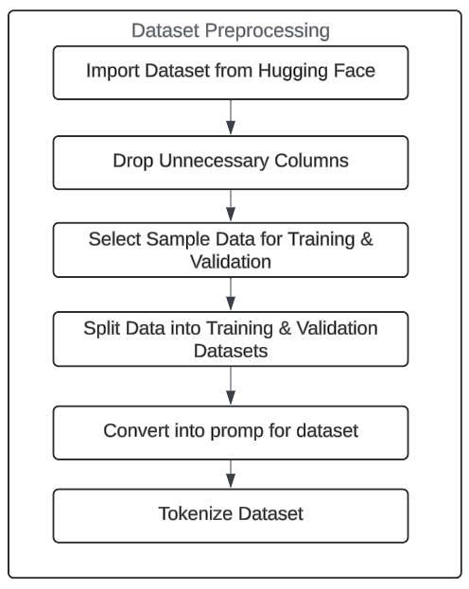
Methodology
FLOW CHART FOR DATA PROCESSING

Slide 8
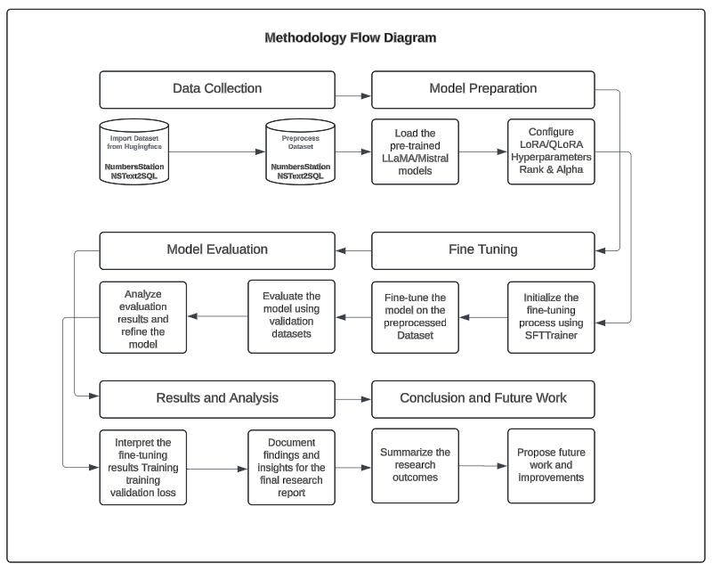
METHODOLOGY
METHODOLOGY FLOW DIAGRAM

Slide 9
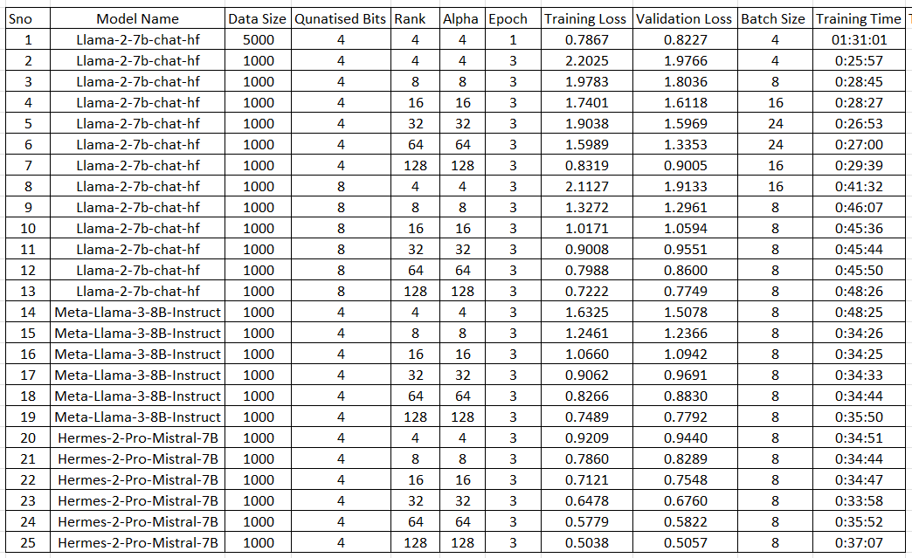
Results & Discussion
FINE TUNNING OBSERVATIONS

Slide 10
Results & Discussion
TRAINING & VALIDATION LOSS Vs RANK & ALPHA

Slide 11
Results & Discussion
TRAINING & VAL LOSS – LLAMA & MISTRAL and RANK & ALPHA

Slide 12
Results & Discussion
INTERPRETATION OF OBSERVATION OF FINE TUNNING
MODEL COMPARISION BY QUANTIZATION BITS
4-bit Quantization: Predominately, models fine-tuned with 4-bit quantization tend to have a higher training loss compared to 8-bit quantization. However, they also demonstrate a shorter total training time
8-bit Quantization: Models fine-tuned with 8-bit quantization generally show lower training and validation losses, indicating better performance
IMPACT OF RANK AND ALPHA
As the Rank and Alpha parameters increase, the training loss generally decreases, indicating improved model performance
TRAINING TIME AND BATCH SIZE CONSIDERATION
A larger batch size generally results in faster training but may not always lead to better validation loss
PERFORMANCE ACROSS MODELS
The Llama models (Llama-2 and Llama-3) tend to show higher training losses compared to the Mistral model (Mistral-7B) when configured similarly
The Mistral model consistently performed better in terms of validation loss

Slide 13
Conclusion & Future Recommendations
EXPANDED HYPERPARAMETER TUNING
Future research should explore additional hyperparameters such as learning rates and dropout rates to enhance model performance beyond the current focus on rank and alpha.
CROSS DOMAIN ADAPTATION
Investigating the application of fine-tuned models in different domains can test their generalizability and provide insights for industry-specific adaptations, such as in healthcare, finance, or e-commerce.
INTEGRATION WITH REAL WORLD DATABASE SYSTEMS
Implementing these models in practical database environments could automate query generation, uncover unforeseen challenges, and assess the models’ effectiveness in real-world scenarios, including handling grammatical errors and minimizing hallucinations.
SCALING WITH LARGER MODELS
Further studies should consider using larger models like Llama-2-13B or Mistral-11B with advanced quantization techniques to improve the accuracy of NL to SQL translation, particularly in complex queries

Slide 14
Conclusion & Future Recommendations
ENHANCED Model INTERPRETABILITY
Future work should focus on making models more interpretable and explainable, especially for critical applications. Techniques such as attention visualization and integrating explainability frameworks could help users understand the model’s decision-making process.
DOMAIN SPECIFIC FINE TUNING
Exploring the fine-tuning of models on domain-specific SQL datasets, such as those from healthcare, finance, or telecommunications, could improve performance in specialized industries by adapting to domain-specific jargon and query structures.
EXPLORATION OF PAID LLM MODELS
Future work could compare the performance of open-source models like Llama and Mistral with paid models such as GPT or Gemini to determine the best approach for various use cases.
OPTIMIZATION TECHNIQUES
Implementing advanced optimization techniques, such as mixed precision training, distillation, and pruning, could reduce computational requirements while maintaining model accuracy, making them more efficient and practical for deployment.

Slide 15


